Slide 1
Shell Sort

Slide 2
Basic Concepts
What is Algorithm ?
What is sorting ?
Why do we need it ?

Slide 3
Shell sort
Donald Shell published the first version of this sort in
1959.
Shell sort is known as shell’s method or Diminishing
insertion sort.
1st algorithm to break the quadratic time barrier but
few years later, a sub quadratic time bound was
proven.

Slide 4
Shell sort
It generalizes an exchanging sort, such as insertion or
bubble sort, by starting the comparison and exchange of
elements with elements that are far apart before finishing
with neighbouring elements.
Starting with far apart elements can move some out-of
-place elements into position faster than a simple nearest
neighbour exchange.
The running time of Shell sort is heavily dependent on the
gap sequence it uses.

Slide 5
Algorithm
int j, p, gap; comparable tmp;
for (gap = N/2; gap > 0; gap = gap/2)
for ( p = gap; p < N ; p++)
{
tmp = a[p];
for ( j = p ; j >= gap && tmp < a[ j- gap ]; j = j - gap)
a[ j ] = a[ j - gap ];
a[j] = tmp;
}

Slide 6


Gap Sequence
General term (k ≥ 1) | Concrete gaps | Worst Case time Complexity | Author and year of publication
Shell,1959
Frank & Lazarus, 1960[5]
Hibbard, 1963[6]
Papernov & Stasevich,
1965[7]

Slide 7
Shell Sort
Shell sort uses a sequence h₁, h₂, …, h_{t} called the
gap sequence . Any gap sequence is fine as long as
h₁ = 1 and some other choices are better than others.
Shell sort makes multiple passes through a list and sorts a number of equally sized sets using the insertion sort.
Shell sort improves on the efficiency of insertion sort by quickly shifting values to their destination.

Slide 8
Shell Sort
Shell sort is also known as Diminishing increment
sort .
The distance between comparisons decreases as the
sorting algorithm runs until the last phase in which
adjacent elements are compared
After each phase and some increment h_{k}, for every
i, we have a[ i ] ≤ a [ i + h_{k} ] all elements spaced h_{k}
apart are sorted.
The file is said to be h_{k} – sorted.

Slide 9
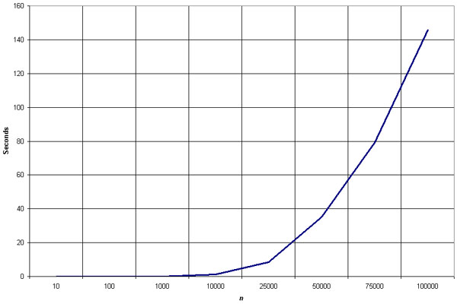
Empirical Analysis of Shellsort

Slide 10
Advantage of Shellsort
Advantage of Shellsort is that its only efficient for
medium size lists. For bigger lists, the algorithm is
not the best choice. Fastest of all O(N²) sorting
algorithms.
5 times faster than the bubble sort and a little over
twice as fast as the insertion sort, its closest
competitor.

Slide 11
Disadvantage of Shellsort
Disadvantage of Shellsort is that it is a complex
algorithm and its not nearly as efficient as the
merge, heap, and quick sorts.
The shell sort is still significantly slower than the
merge, heap, and quick sorts, but its relatively simple
algorithm makes it a good choice for sorting lists of
less than 5000 items unless speed important.
It's also an excellent choice for repetitive sorting of
smaller lists.

Slide 12
Best Case
The best case in the shell sort is when the array is already sorted in the right order. The number of comparisons is less.

Slide 13
Worst Case
The running time of Shell sort depends on
the choice of gap sequence.
Shell sort's worst-case performance using Hibbard's increments is Θ(n^{3/2}).

Slide 14
Shell Sort Example
Sort: 18 32 12 5 38 33 16 2
8 Numbers to be sorted, Shell’s increment will be floor(n/2)
* floor(8/2) ➔ floor(4) = 4
increment 4:
1 2 3 4
(visualize underlining)
18 32 12 5 38 33 16 2
Step 1) Only look at 18 and 38 and sort in order ;
18 and 38 stays at its current position because they are in order.
Step 2) Only look at 32 and 33 and sort in order ;
32 and 33 stays at its current position because they are in order.
Step 3) Only look at 12 and 16 and sort in order ;
12 and 16 stays at its current position because they are in order.
Step 4) Only look at 5 and 2 and sort in order ;
2 and 5 need to be switched to be in order.

Slide 15
Shell Sort Example (con’t)
Sort: 18 32 12 5 38 33 16 2
Resulting numbers after increment 4 pass:
18 32 12 2 38 33 16 5
* floor(4/2) ➔ floor(2) = 2
increment 2:
1 2
18 32 12 2 38 33 16 5
Step 1) Look at 18, 12, 38, 16 and sort them in their appropriate location:
12 38 16 2 18 33 38 5
Step 2) Look at 32, 2, 33, 5 and sort them in their appropriate location:
12 2 16 5 18 32 38 33

Slide 16
Shell Sort Example (con’t)
Sort: 18 32 12 5 38 33 16 2
* floor(2/2) ➔ floor(1) = 1
increment 1:
1
12 2 16 5 18 32 38 33
2 5 12 16 18 32 33 38
The last increment or phase of Shellsort is basically an Insertion
Sort algorithm.

Slide 17
Thank You

